Slide 1
Research and Development for Extreme Temperature Insulation
Amy Gladwin, Pima Community College
Mentors: Michael Sampogna & Anthony Pitucco, Pima Community College
19th Annual Arizona /NASA Space Grant Symposium
University of Arizona
April 17, 2010

Slide 2
Our High Altitude Student Platform (HASP) payload
Utilizes a transistor circuit with a lower limit temperature specifications ranging between 18 to 20 °C
At 36km altitude, ambient temperatures approach
-55°C
Integration of a heater facilitates limited thermal radiation

Slide 3
Thermodynamic Challenges
Our Challenges
Insulating Material must have properties:
  HASP weight limitations
  Dimensional limitations
  Ambient conditions
  Budget constraints
  LED temperature specs
  Low density
  Durable
  Flexible
  Inexpensive
  Efficiently reflect heat

Slide 4
Insulation Prototypes
Wool felt material in various configurations
Wool felt integrated with polyethylene film
Silk material
Thin sheets of fiberglass material integrated with polyethylene
Thick sheets of fiberglass material integrated with polyethylene
Notes:
We then integrated the felt material between sheets of low density polyethylene film designed to proficiently reflect heat. This prototype was much more efficient than the last, but not yet efficient enough. We tried multiple variations of material with varying numbers of layers. We ultimately determined we needed a better insulating material. Research led us to a low density, flexible, inexpensive fiberglass material which we have integrated with the polyethylene film in alternating layers.

Slide 5
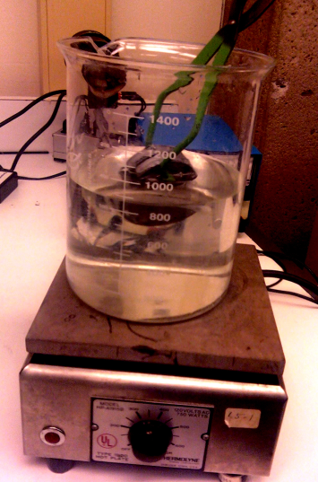
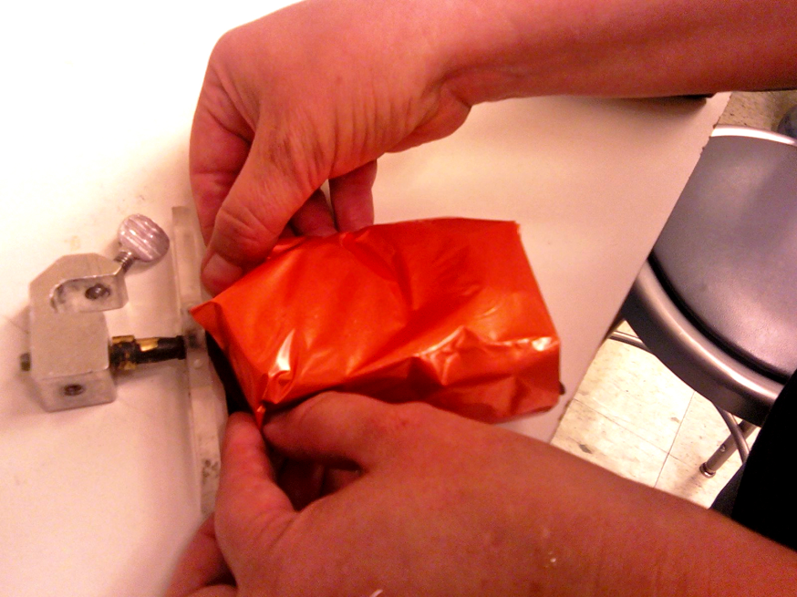
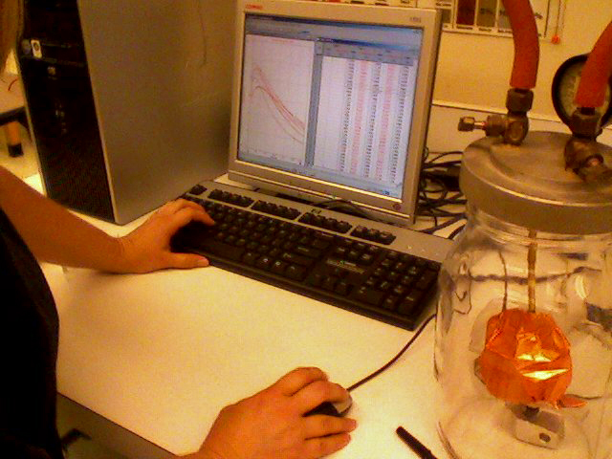
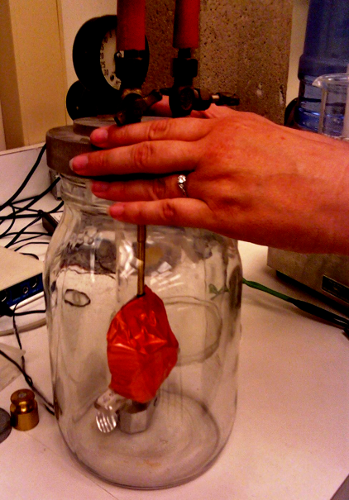
Testing Insulation Efficiency
Notes:
To test insulating efficiency, we wrapped the insulation around a kilogram of metal heated to 100°C and used a thermocouple integrated with Loggerpro software to plot Temperature vs Time curves. This proved an easy way to compare prototypes: steeper differential rates of cooling indicated poor insulation.

Slide 6
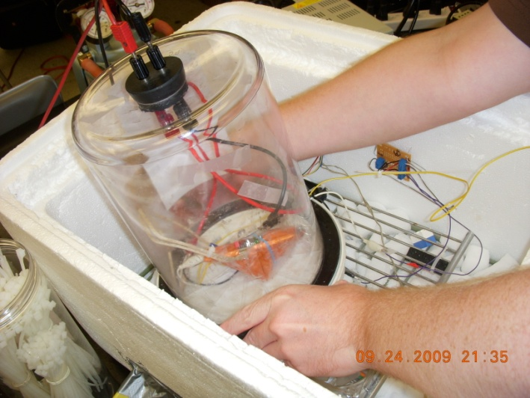
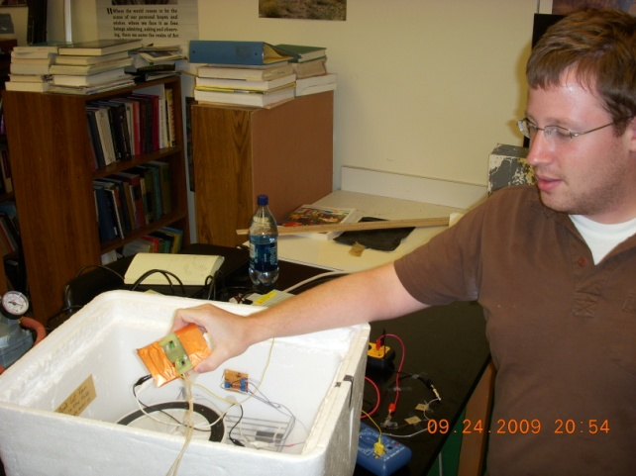
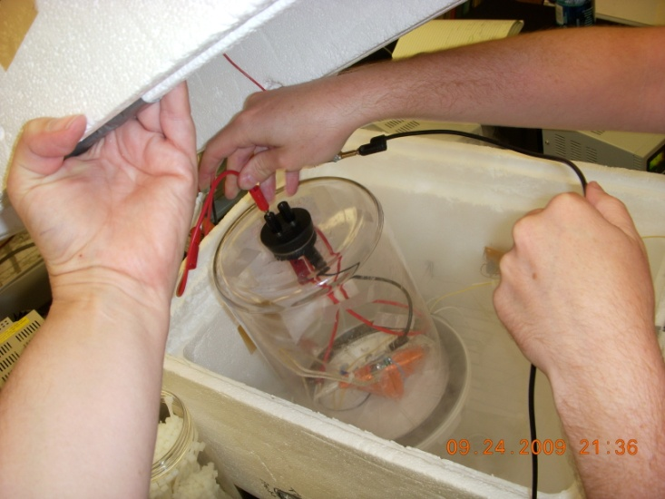
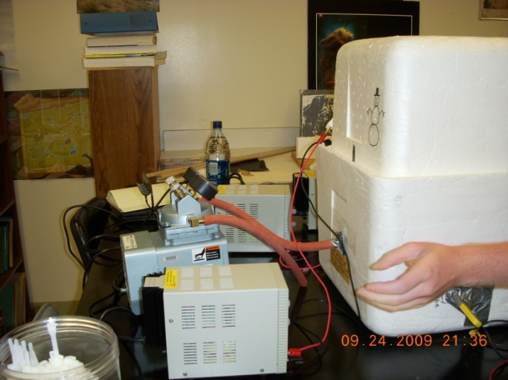
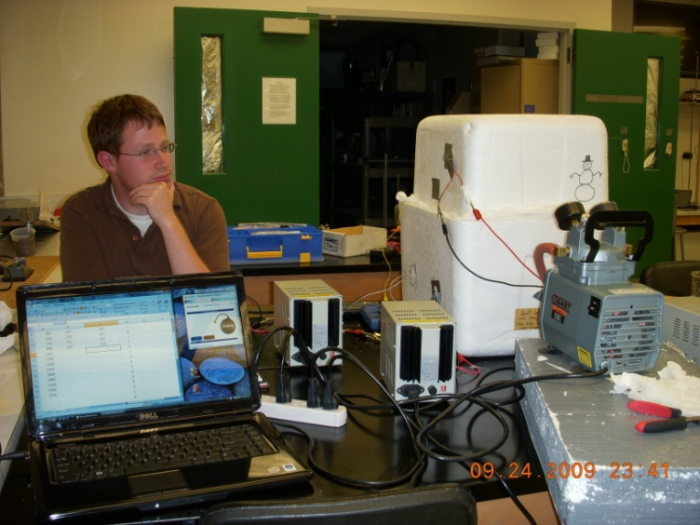
Simulating Near-Space Conditions

Slide 7
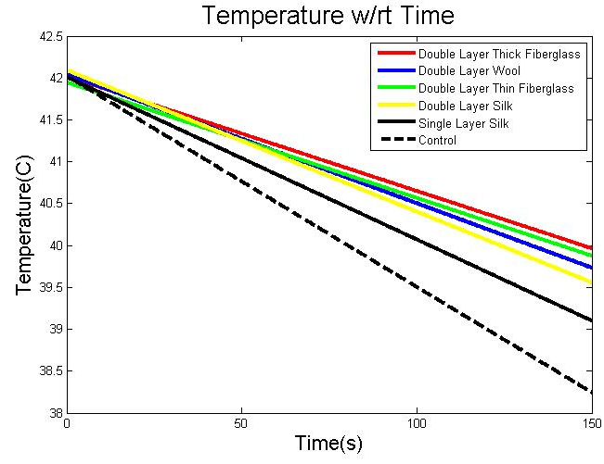
Results

Slide 8
Thank you
Arizona/NASA Space Grant Consortium
Pima Community College
High Altitude Student Platform
ASCEND!
Forrest Mims
Michael Sampogna
Anthony Pitucco
Denise Meeks
Peter Kozak

